Slide 1

NYHDIF May 2019
Update
Monica Jones
Twitter @YHCareRecord
Email hnf-tr.yhcr@nhs.net

Slide 2
Our Principles
Clinically Driven - all development is driven by real clinical and/or social-care use-cases. Ensuring that technology serves the real needs of citizens and staff
Agile – we work incrementally, proving capability at each step, and adapting based on what we learn
Open - our approach is based on open standards and open-source software
Flexible - Data is assembled as needed – either for direct patient care, or for agreed Population Health Management / Research use cases
Reuse – we build on what we’ve got – joining together existing investments into a region-wide fabric for information sharing
Locally Led – We want to build a real community in our region – working together to develop solutions and improve care

Slide 3
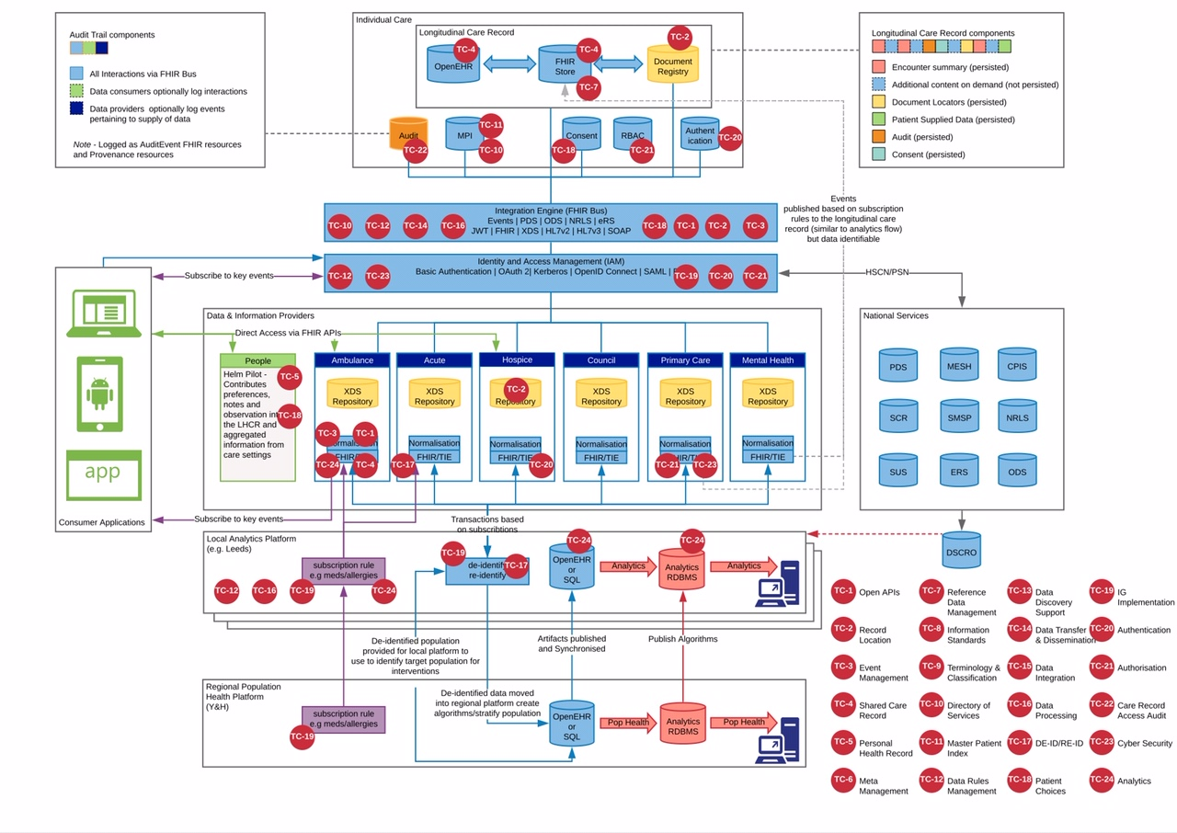
1a) System of Systems pilot
Core messaging infrastructure developed
Initial proving on a limited scale
Rollout to initial subset of 6 organisations demonstrating Direct Care via real use-cases
Temporary low-volume hosting for pilot
STATUS: Completion Spring 2019
MS3
MS7b
Coordinated Care Planning and NHS App
2a) PHR Pilot
Initial proving of Helm PHR application
Enable:
  Patient viewing of GP record
  Patient recording of 3 key facts
  Clinician viewing in one hospital
Limited small-scale patient rollout
Temporary low-volume hosting for pilot
STATUS: Completion Spring 2019
MS7a
1b
Coordinated Care Planning and NHS App
2b
MS4
MS4
Longitudinal Record at Point of Care
MS2
Interop between LHCRE
1b) System of Systems rollout
Phased rollout to wider organisations, based on prioritised real-life use-cases
Develop local organisation on-boarding and support package
Further development of advanced messaging infrastructure features (including bulk extracts for PHM)
Development of Care Planning use-cases
Demonstration of LHCRE-LHCRE interop
Rehosting on high-volume operational infrastructure
STATUS: In Procurement
1a
2b) PHR Rollout
Further development of PHR application, based on real-life use-cases
Wider rollout to additional patients and care-settings
Rehosting on high-volume operational infrastructure
STATUS: In Procurement
MS3
MS5
Regional Deployment of Longitudinal Record
Person Held Record
2a
1b
MS5
MS2
MS7b
MS7a
MS6
Longitudinal Record Supports Access to Pseudonymised Data
3) Population Health
Initial piloting of PHM extraction tooling based on one real-life use-cases in one analytics environment
Further development of PHM with additional use-cases and movement of data between additional analytics environments
Three procurement lots:
  PHM / Analytics tooling
  Integration / extraction infrastructure
  Hosting
  STATUS: In Procurement
3
MS8
Movement of Pseudonymised Data between Centres of Analytics
MS6
MS8

Slide 4
Further technical detail is available via published detailed design papers
# | Title
001 | A Unified Distributed Data Model for FHIR
002 | Data Availability Service
003 | Conceptual Design for a FHIR Proxy Server
004 | Patient Identity Exchange (PIX/MPI)
005 | Identity and Access Management (IAM) Service
006 | Reliable Messaging Infrastructure
007 | Subscriptions Infrastructure*
008 | Consent Management*
009 | Auditing
010 | FHIR Aggregator Service
011 | Interfaces with the Personal Demographic Service (PDS)
012 | Interfaces with the Electronic Staff Record (ESR)
013 | Interfaces with the Organisational Data Service (ODS)
014 | Governance for Data Providers*
015 | Governance for Data Consumers*
016 | Securing the YHCR
017 | Data Quality Reporting*
018 | Regional FHIR Store
019 | Document Management
021 | Non-Functional Requirements for Regional Infrastructure
020 | Onboarding Data Providers*
021 | Onboarding Data Consumers*
022 | YHCR FHIR Resource Profiles*
023 | The YHCR Maturity Model*
024 | FHIR and the Co-ordination of Care*

Slide 5
Initial Pilot Sites and Clinical Use Cases
Doncaster Patient Encounters visible in the Rotherham Care Record
Achieved by:
Live Doncaster Encounter records exposed over the FHIR proxy.
The creation of a user interface screen within Sepia to display a list of Doncaster Encounters for a given Patient NHS Number.
Rotherham Patient Encounters visible in the Leeds Teaching Hospitals Care Record (PPM+)
Achieved by:
Live Rotherham Encounter records exposed over the FHIR proxy.
The creation of a user interface screen within PPM+ to display a list of Rotherham Encounters for a given Patient NHS Number.
Ambulance Transfer of Care records visible in the Doncaster Care Record
Achieved by:
Live Ambulance Transfer of Care records exposed over the FHIR proxy.
The creation of a user interface screen within Doncaster’s Care Record to display an Ambulance Transfer of Care for a given Patient NHS Number.
Humber Mental Health Care Crisis Plans visible in the Yorkshire Ambulance Service Care Record
Achieved by:
Live Mental Health Care Crisis Plan records exposed over the FHIR proxy.
The creation of a user interface screen within Yorkshire Ambulance Service Care record to display a Mental Health Care Crisis plan for a given Patient NHS Number.
Rotherham Do Not Attempt Resuscitation (DNAR) status visible in the Yorkshire Ambulance Service Care Record
Achieved by:
Live DNAR status records exposed over the FHIR proxy.
The creation of a user interface screen within Yorkshire Ambulance Service Care record to display the DNAR status for a given Patient NHS Number.
Rotherham Inter Provider Cancer Transfer form visible in Leeds Teaching Hospitals PPM+
Achieved by:
Live Rotherham Inter Provider Transfer forms exposed over the FHIR proxy.
The creation of a user interface screen within PPM+ to display an Inter Provider Cancer Transfer form for a given Patient NHS Number.
Humber Social/Mental Health Care Teams informed of “Frequent Flyer” attendances at Leeds Teaching Hospitals
Achieved by:
Emergency Department attendances published from Leeds Teaching Hospitals’ PPM+ Care Record as soon as the attendance begins.
Email sent to nominated care team at Humber and Vale.
Yorkshire Ambulance Service informed of the outcome of Emergency Department attendances at Rotherham
Achieved by:
Emergency Department attendances published from Rotherham’s Care Record upon completion.
Attendance data sent to Yorkshire Ambulance Service’s information/quality and performance team.
Doncaster Acute
Rotherham Acute
Humber Teaching NHS FT
Leeds Teaching Hospitals
York Council
Yorkshire Ambulance Service

Slide 6
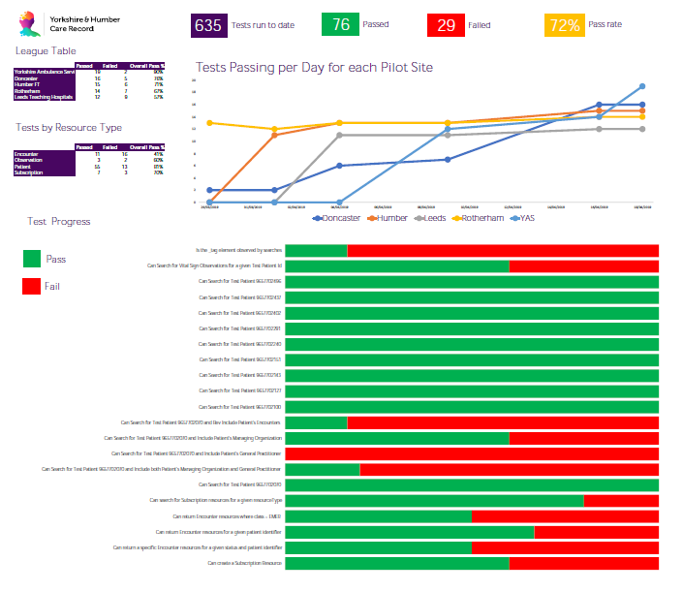
Pilots Progress Report
An automated testing tool has been developed and provides weekly updates.
The initial wave of pilots will prove the core capabilities - and is now nearing completion.

Slide 7
What is Population Health Management?
Recognises that health and wellbeing is more than just being ‘without disease’.
It moves away from managing disease in silos to an approach based on defined populations of people, who may have multiple ‘disease conditions’.
PHM hinges heavily on the use of new technologies and richer information.

Slide 8
Why?
There are five overall aims of Population Health Management:
Improve the health and wellbeing of the population
Enhance experience of care and support
Reduce per capita cost of care and improve productivity
Increase the well-being and engagement of the workforce
Address health and care inequalities
How?
Culture change
Better engagement
Outcomes focus
Improved contracting
Provider innovation

Slide 9
PHM Technical Architecture
The proposed architecture adopts a tiered approach to data acquisition and analysis. It is tiered because it enables analysis to take place at different levels of the healthcare system.
Community analytics platforms allow care providers, who have common responsibility to a geographical community of patients, to apply analytical methods for health planning, risk stratification, and health and service improvement. It allows the same data to be aggregated at a regional or national level in support of strategic initiatives or for data-led research.
Learnings from regional and national levels can be applied at a community level as algorithms running against data acquired in near real-time.

Slide 10
Population Health Management Procurements – 3 LOTs
1. Integration Architecture. This includes building the platform and defining data flows. It will need to integrate with System of Systems to access data from across the region as required for monitoring and analytics purposes. It must also integrate with the NHS Digital de-identification service to enable de-identification of data its use in analytics.
2. Business Intelligence (BI) Tooling and Expertise. Provision of BI tooling to support creation of “data cubes” for analytics, and provide data visualisation and informatics capability, and integrate with more advanced data analytics methods (e.g. R and Python coding). This Lot also includes a knowledge transfer component to support use of the tooling by the YHCR used groups. The intellectual property (IP) resides with YHCR. A library of reusable components would be created that can be shared across YHCR (and other LHCREs).
3. Hosting of cloud-based platform. This component will provide a flexible and elastic hosting environment for the Integration Architecture and BI tooling. It is intended that this hosting provider shall also host and support System of Systems (SoS).

Slide 11
Procurement Timelines
Date | Activity
10/12/2018 | Proposed Population Health approach and technical architecture agreed by Delivery Board
22/01/2019 | Pop health workshop held to inform Population Health requirements
17/01/2019 | Yorkshire and Humber Care Record Delivery Board approve "conceptual" design
11/02/2019 | Population Health requirements validation meeting
14/03/2019 | ITT documents approved
18/03/2019 | Supplier webinar held to explain tender
19/03/2019 | Tender documents issued and bid period commences
22/03/2019 | Deadline for submission of clarification questions
12/04/2019 | Supplier bid submission deadline
15/04/2019 | Evaluation kick-off
30/04/2019 | Bid Evaluation Moderation Session
07/05/2019 | Supplier presentation and final evaluation day
15/05/2019 | Yorkshire and Humber Care Record Delivery Board approve preferred supplier and spend
17/05/2019 | Extraordinary meeting of Yorkshire and Humber Digital Board to ratify preferred supplier
22/05/2019 | Humber Teaching NHS Foundation Trust Board approve recommended supplier and spend
24/05/2019 | Preferred Supplier status notified
07/06/2019 | Standstill period ends and contracts signed
10/06/2019 | Supplier commencement

Slide 12

Questions ?
NOW OR later

